Slide 1
Colon Cancer Treatment
The Perspective of a Medical Oncologist
Dr Oliver Klein

Slide 2
Cancer | Australia
(Sydney Morning Herald 2012)

Slide 3
Colon Cancer | Epidemiology- Australia
Most common cancers 2012
Cancer related deaths 2010
Australian Institute of Health and Welfare

Slide 4
Colon Cancer | Incidence
Women
Men
(American Cancer Society 2011, Merck-Serono)

Slide 5
Colon Cancer | – Disease stage at diagnosis
( Merck-Serono)

Slide 6
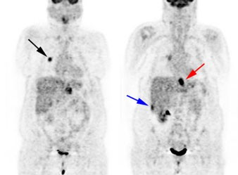
Colon Cancer | Sites of metastases
Liver
Lung
Peritoneum
Bone
Brain

Slide 7
Colon Cancer | Adjuvant therapy
(Merck_Serono)

Slide 8
Colon Cancer | Treatment goals for the Oncologist
CRC Stage II/III
CRC Stage IV
Cure
Cure
Prolong
Survival
Improve
Symptoms

Slide 9
Colon Cancer | Therapy Timeline
(Merck-Serono)

Slide 10
Colon Cancer | Available agents
Cytotoxic agents
Targeted agents
5-Fluorouracil
Irinotecan
Oxaliplatin
Capecitabine
Bevacizumab
Aflibercept
Cetuximab
Panitumumab
Regorafenib

Slide 11
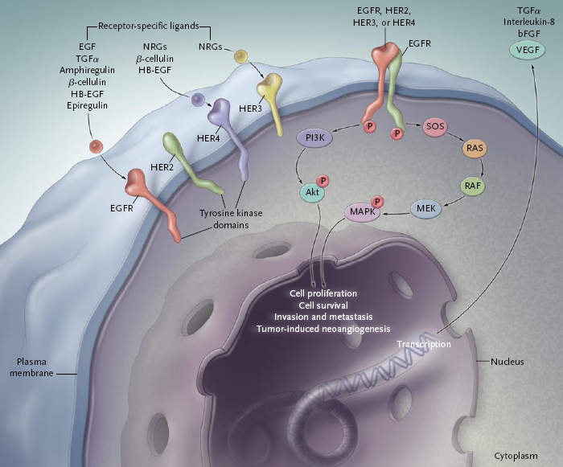
Colon Cancer | Targeted agents – EGFR antibodies
Cetuximab
Pannitumumab
Biomarker
Toxicity
Rash
Diarrhoea
Hypomagnesaemia
Hypersensitivity reaction
(Ciardiello et al,2008)
(Pinto et al,2011, Merck-Serono)

Slide 12
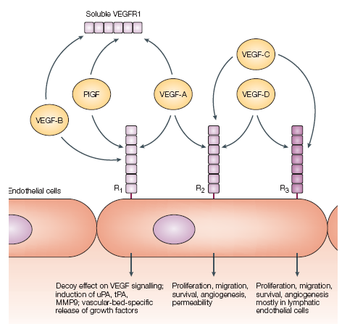
Colon Cancer | Targeted agents – angiogenesis inhibitor
Bevacizumab
Aflibercept
Biomarker
None!
Toxicity
Arterial hypertension
Proteinuria
Venous thrombosis
Arterial thrombosis
GI perforation
(Ferrara et al, 2004)

Slide 13
Colon Cancer | Adjuvant chemotherapy for stage III
Significant survival benefit
FOLFOX better than 5-FU alone
(Koehne, 2012)

Slide 14
Colon Cancer | Adjuvant chemotherapy
(Courtesy Merck-Serono)

Slide 15
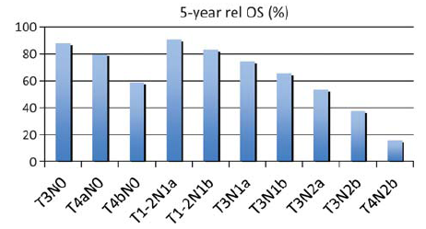
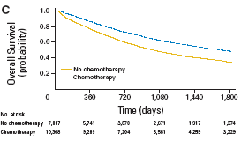
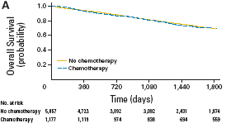
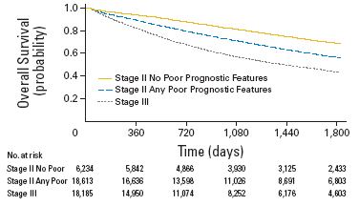
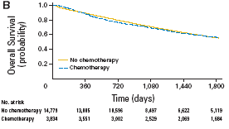
Colon Cancer | Adjuvant chemotherapy for stage II disease
Poorly differentiated
Lymphovascular/vascular invasion
Obstruction
Perforation
pT4
<12 lymph nodes retrieved
(Koehne, 2012; O’Connor et al,2011)

Slide 16
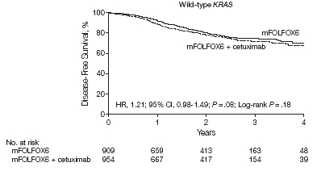
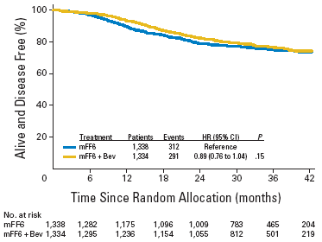
Colon Cancer | Adjuvant therapy – new agents
EGF-R inhibitors
Anti-angiogenic agents
(Ciardiello et al,2008)
(Ferrara et al,2004)
(Alberts et al,2012)
(Allegra et al,2011)

Slide 17
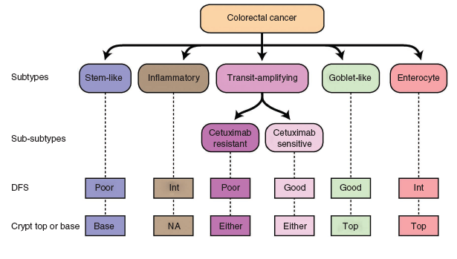
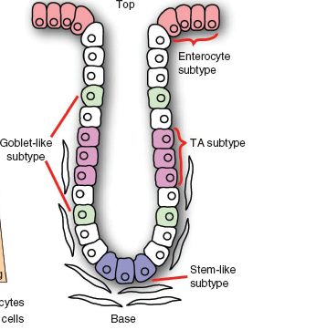
Colon Cancer | Adjuvant therapy – Biology will help
(Sadanandam et al, 2013)
(Tabernero,2013)

Slide 18
Colon Cancer | Metastatic disease
(Kopetz et al,2009)

Slide 19
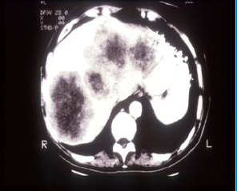
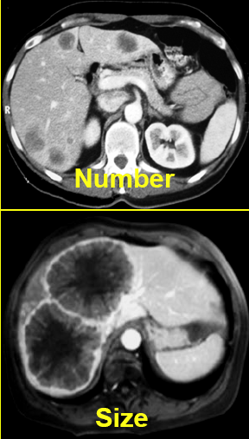
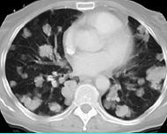
Colon Cancer | Metastatic disease is heterogenous

Slide 20
Colon Cancer | Metastatic disease – Case 1
Curative approach

Slide 21
Colon Cancer | Metastatic disease – Case 1
A 54 year old gentleman presented to the emergency department with a large bowel obstruction due to a tumour in the sigmoid colon.
A CT scan revealed a solitary liver lesion in keeping with a metastasis.
He subsequently underwent a partial left hemicolectomy with the pathology demonstrating a moderately differentiated adenocarcinoma invading through the muscularis layer into the subserosa with three out of 19 lymph nodes involved by carcinoma.
A liver MRI and a FDG-PET scan demonstrated no additional sites of disease apart from the right liver metastasis.
Six weeks later he has undergone a right sided hemihepatectomy.
The patient subsequently received 12 cycles of FOLFOX chemotherapy and is free of disease since more than three years.

Slide 22
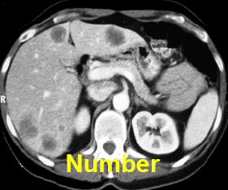
Colon Cancer | Metastatic disease – Case 2
Potentially curable

Slide 23
Colon Cancer | Metastatic disease – Case 2
A 67 year old female was diagnosed with a left sided screening detected colon cancer in 2008 that has been resected and been demonstrated to be a moderately differentiated adenocarcinoma invading through the muscularis layer with 2 out of 16 lymph nodes involved by carcinoma. A CT scan at the same time revealed no evidence for metastatic disease. The patient declined adjuvant chemotherapy.
At a follow up visit, 18 months later, blood tests demonstrated an elevated CEA level (20ug/L) and a subsequent CT scan revealed 5 liver metastases.
She commenced treatment with bevacizumab/FOLFOX and a restaging CT scan after 3 months of treatment demonstrated a significant reduction in size of all liver metastases.
She subsequently underwent resection of her left liver lobe that was followed by another three months of chemotherapy. Oxaliplatin had to be discontinued due to increasing sensory neuropathy.
Subsequently radiofrequency ablation of two residual right sided liver metastases were undertaken.
The patient is free of disease more than two years after completion of her last chemotherapy with unremarkable imaging studies and CEA levels being in normal range.

Slide 24
Colon Cancer | Metastatic disease – Case 3
Palliative approach

Slide 25
Colon Cancer | Metastatic disease – Case 3
A 72 year old gentleman presented to his general practitioner with shortness of breath; a chest x-ray revealed multiple round opacities suspicious for metastases.
A subsequent CT scan demonstrated widespread metastatic disease in liver and lung with a suggestion of bowel wall thickening in the sigmoid colon.
A colonoscopy revealed an ulcerating tumour in the sigmoid area with the biopsy confirming a poorly differentiated adenocarcinoma.
He commenced on FOLFOX chemotherapy in combination with bevacizumab with a continuous decline in CEA serum levels and restaging CT scans after 3 and 6 months demonstrated a partial remission.
Six months after treatment commencement, bevacizumab was continued in combination with the oral chemotherapy capecitabine.
Six months later, treatment was stopped due to increasing fatigue and intolerable hand-foot syndrome; CT scans at that time revealed ongoing stable disease.
Another four months later, a CT scan demonstrated significant disease progression with an increase in size of the pre-existing liver and lung metastases and three new lytic bony metastases in the thoracic spine.
FOLFIRI chemotherapy was commenced and serum CEA levels and a CT scan after three months demonstrated a partial remission that was followed by progression two months later.
The tumour tissue testing revealed K-RAS wildtype and the patient was commenced on Cetuximab with a response in his serum CEA levels and a minor radiological response.
Four months after commencing Cetuximab significant disease progression occurred and treatment was stopped, the patient deceased two months later.

Slide 26
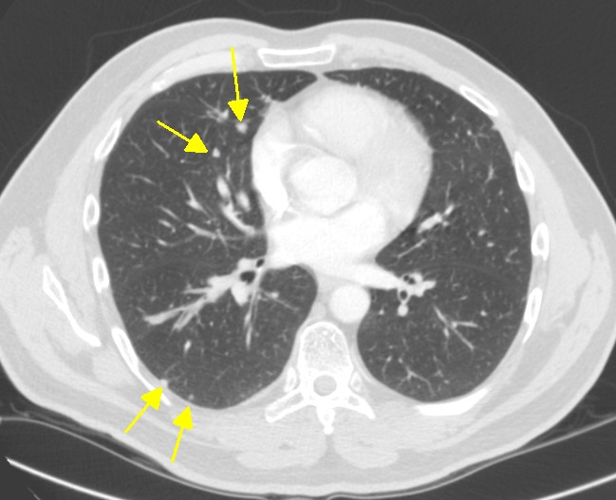
Colon Cancer | Metastatic disease – Case 4
Palliative approach

Slide 27
Colon Cancer | Metastatic disease – Case 4
A 76 year old gentleman underwent in June 2008 a resection of a left sided colon carcinoma with the pathology revealing a pT3pN0 tumour.
Four years later, he was involved in a car accident and a CT scan performed at the emergency department to exclude trauma injuries revealed multiple sub-centimetre nodules in the right lung.
A follow up CT scan 2 months later demonstrated a slight increase in size of the majority of the pulmonary lesions.
Further imaging over the next six months showed a further increase in size of most of the pulmonary lesions with new nodules developing in his left lung.
Four months later, the patient developed chronic cough and a right upper lobe nodule measuring 1.8cm was biopsied with the histopathology demonstrating an adenocarcinoma (immunohistochemistry CK7+/CK20-/CDX2+/TTF1-); his CEA level at that time was 24ug/L.
The patient was commenced on oral capecitabine chemotherapy in combination with bevacizumab leading to an decrease in the serum CEA level and a restaging CT scan after three months demonstrated a slight decrease in size of his pulmonary metastases.
He continued for another four months on treatment with follow up CT scans demonstrating stable disease. At that time, the patient asked for a treatment break.
Three months after his last oral chemotherapy, restaging scans demonstrated moderate disease progression and the same treatment regimen was recommenced.
A follow up CT scan demonstrated stable disease under this therapy with the patient alive 25 months after being diagnosed with metastatic disease

Slide 28
Colon Cancer | Metastatic disease is heterogeneous
(Schmoll et al, 2012, Merck-Serono)

Slide 29
Colon Cancer | Metastatic disease
How to best sequence and combine our
therapeutics to achieve the best outcome?
Which of the two targeted agents is more effective?
Is the combination of both targeted agents better than one alone?
Is it beneficial to treat patients beyond progression?
Is there an ideal chemotherapy backbone for each of the targeted agents
Is there any role for resection of the primary cancer in the setting of incurable metastatic disease?

Slide 30
Thank you for your attention !

