Slide 1
MRs GE

Slide 2
MRs GE
72 years old retired Market Researcher.
3 month history of increasing fatigue associated with one week of drenching night sweats.
B/G: URTI with longstanding cough.
Referred from GP with abnormal blood film and marked splenomegaly with retroperitoneal LAD on CT (Abdo)
Denied weight loss/fevers

Slide 3
Past medical history
Tonsillectomy (3yo)
Appendectomy (17yo)
Unilateral Oophorectomy (17yo)
Hysterectomy (38yo)
Hypertension
Tibolone
Atenolol
Doxepin

Slide 4
Social History
Retired Financial Researcher
From home with Husband (Marketing)
Two adopted daughters (Bentleigh/Malvern)
Previously very fit & fiercely independent

Slide 5
On examination
Orientated
Chest: Reduced bibasal air entry. Creps to mid zones.
Abdomen: Mild Splenomegally. SNT.
Peripherally: Right calf swelling. Not tender to palpation.
X X X X
X X X X
>

Slide 6
Investigations
Hb 84
Neut 2.0
Lymph 1.8
Mono 1.7 H
ALP: 118
GGT: 184
ALT: 80
AST: 87
Br: 13
LDH: 567

Slide 7
investigations
BMAT: Markedly hypercellular marrow with extensive infiltration by large B cell lymphoma. Normal bony trabecular architecture. Markedly reduced erythro/granulopoeisis. CD 20 strongly positive on IHC and CD3 minor component of admixed T cells.
CT CAP: 16cm Splenomegally, retroperitoneal lymphadenopathy up to 1.5cm in diameter. Shotty inguinal lymph nodes. Nil chest involvement.
PET: Awaiting results
ECHO: EF 70 percent. Mild MR/TR.

Slide 8
Epidemiology & Risk factors
NHL represents the fifth most common malignancy diagnosed in men and the sixth most common in women, with the incidence being approximately 39% higher in men. Most cases of non-Hodgkin lymphoma occur in adults aged 65 years and older.
The risk of developing it increases as you get older (it can also occur in children and young adults)
Risk Factors
Previous infections with viruses such as Epstein-Barr virus, human immunodeficiency virus (HIV), human T-lymphotropic virus type 1 (HTLV-1) and hepatitis C
Chemical exposure including pesticides, fertilisers or solvents
Autoimmune diseases including rheumatoid arthritis, scleroderma and Sjögren’s syndrome
Previous organ transplant
Infections with certain bacteria including Helicobacter pylori
A family history of NHL.

Slide 9
NHL subtypes
B-Cell Lymphomas | T-Cell Lymphomas
Precursor B-cell lymphomas Precursor B-cell lymphoblastic leukaemia/lymphoma | Precursor T-cell lymphomas Precursor T-cell lymphoblastic leukaemia/lymphoma
Mature B-cell lymphomas Follicular lymphoma Mantle cell lymphoma Diffuse large B-cell lymphoma: Mediastinal large B-cell lymphoma Burkitt’s lymphoma B-cell chronic lymphocytic leukaemia/small lymphocytic lymphoma Marginal zone lymphomas: Extranodal marginal zone B-cell lymphoma of mucosa-associated lymphoid tissue (MALT) type Splenic marginal zone B-cell lymphoma Nodal marginal zone lymphoma Lymphoplasmacytic lymphoma (Waldenstrom’s macroglobulinaemia) | Mature T-cell lymphomas Adult T-cell leukaemia/lymphoma Anaplastic large cell lymphoma Cutaneous T-cell lymphoma (including mycosis fungoides and Sezary syndrome) Peripheral T-cell lymphomas: Subcutaneous panniculitis-like T-cell lymphoma Hepatosplenic gamma-delta T-cell lymphoma Enteropathy-type intestinal T-cell lymphoma Extranodal T-cell lymphoma, nasal type Angioimmunoblastic T-cell lymphoma Peripheral T-cell lymphoma, unspecified

Slide 11
Ann arbor staging
Stage I Single nodal area or structure Stage II Two or more nodal areas on the same side of the diaphragm Stage III Nodal areas on both sides of the diaphragm Stage IV Extranodal involvement
B Symptoms
Fever >38°C
weight loss >10% in the preceding 6 months
drenching night sweats

Slide 12
International prognostic index

Slide 13
International prognostic index

Slide 14
MRS GE’s prognosis

Slide 15
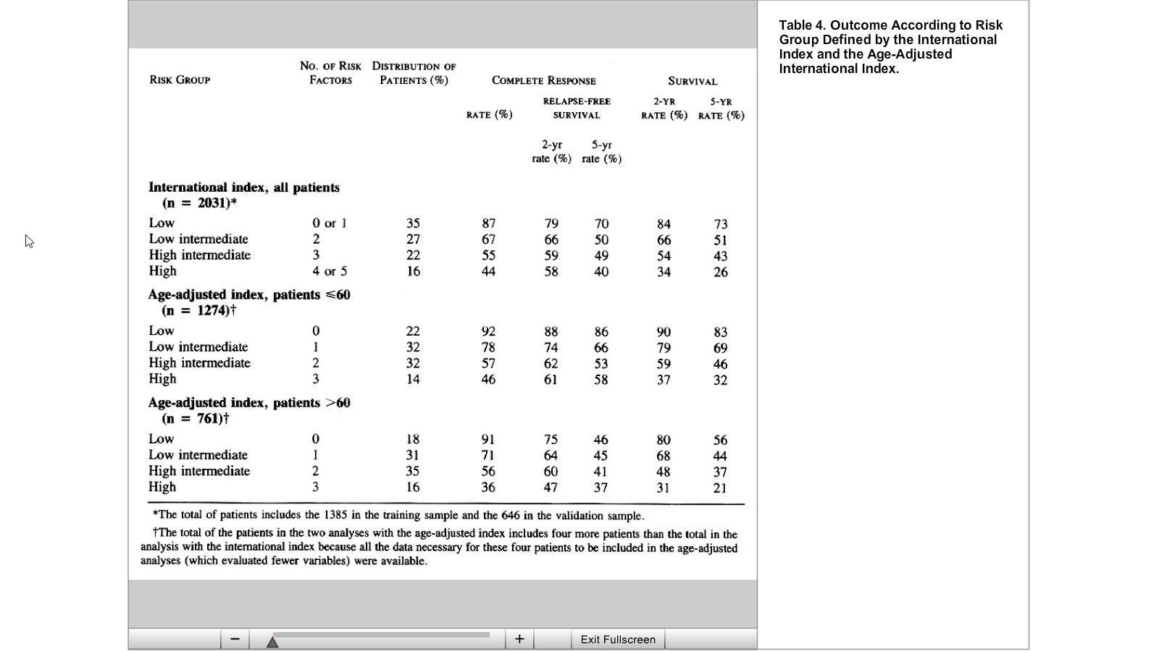
MRS GE’s prognosis

Slide 16
Coiffier, et al. NEJM. 2002.
Population/Methods
Untreated patients with diffuse large-B-cell lymphoma
60 to 80 years old CHOP every three weeks (197 patients) versus CHOP plus rituximab given on day 1 of each cycle (202 patients)
Results
Complete response was significantly higher in the group that received CHOP plus rituximab than in the group that received CHOP alone (76 percent vs. 63 percent, P=0.005).
The addition of rituximab to standard CHOP chemotherapy significantly reduced the risk of treatment failure and death (risk ratios, 0.58 [95 percent confidence interval, 0.44 to 0.77] and 0.64 [0.45 to 0.89], respectively).
Continued…

Slide 17
event-free an OS times were sig. higher in the CHOP-R group (P<0.001 and P=0.007, respectively).

Slide 18
Clinically relevant toxicity was not significantly greater w CHOP plus rituximab.

Slide 19
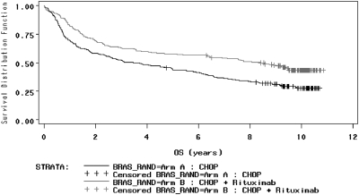
Long term outcomes

Slide 20
Long term outcomes

Slide 21
A Predictive Model for Aggressive Non-Hodgkin's Lymphoma. New England Journal of Medicine 329, 987-994, doi:doi:10.1056/NEJM199309303291402 (1993).
Coiffier, B. et al. CHOP Chemotherapy plus Rituximab Compared with CHOP Alone in Elderly Patients with Diffuse Large-B-Cell Lymphoma. New England Journal of Medicine 346, 235-242, doi:doi:10.1056/NEJMoa011795 (2002).
Coiffier, B. et al. Long-term outcome of patients in the LNH-98.5 trial, the first randomized study comparing rituximab-CHOP to standard CHOP chemotherapy in DLBCL patients: a study by the Groupe d'Etudes des Lymphomes de l'Adulte. Vol. 116 (2010).

