Slide 1
Lynch Syndrome and BRCA 1/2

Slide 2
Case 1
21 yo female px to GP with 3/52 of severe abdominal pain colicky in nature with no relieving sx
Associated with nausea and reduced appetite
2 presentation to ED with nil Ix
PMHX:
Asthma
Social HX:
Smoker
Works as an retail assistant
Family Hx:
Nil known

Slide 3
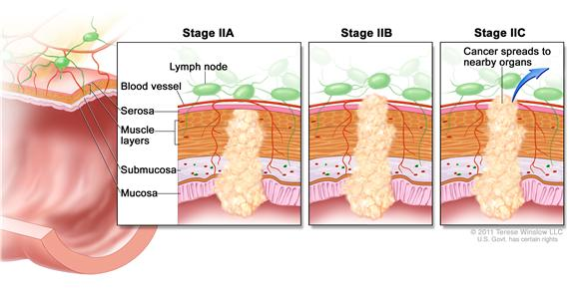
CT Abdo:
Suspicious mass colon with lymphadenopathy
Colonoscopy:
hepatic flexure lesion with biopsy proven malignancy
Laparotomy:
T4aN0 Adeno CA Bowel
penetrates to the surface of the visceral peritoneum with micro- perforation
Stage IIB MSI H
Mx?

Slide 4
Case 2
35 year old female
Px for review following WLE and SNB after px with a self detected breast mass
PMHX:
G2P1
Social Hx:
Teacher
Ex-smoker
Family Hx:
Mother Breast CA 50
Aunty ovarian CA 60s

Slide 5
Case 2
Histology
Grade 3 15 mm Triple negative IDC
Margins clear
½ SN Ki 67 50%
Axillary clearance 2/12 LN
Commenced on adjuvant chemo therapy
Referred to Familial Cancer clinic
Found to have a BRCA 1 mutation
MX?

Slide 6
Lynch Syndrome (LS)
Approximately 5% of CRC cancers are hereditary
LS most common of the inherited colon cancer susceptibility syndromes
Increase risk malignancy
CRC, Endometrial CA
gastric
ovarian
pancreases
urinary tract
biliary tract
brain
small intestine
skin

Slide 7
Characteristics
Early age of onset CA
Multiplicity of cancers
Synchronous colorectal cancers
Metachronous colorectal cancer
Proximal location in the right colon
Improved stage-independent survival relative to sporadic CRC

Slide 8
Classic Histology CRC
Mucinous histology
Poorer differentiation
Medullary growth pattern
Presence of tumor infiltrating lymphocytes

Slide 9
Endometrial cancer
2-5% endometrial carcinomas
Classically Endometrioid histology
similar to sporadic endometrial cancer.
serous carcinoma,
clear cell carcinoma,
uterine malignant mixed mullerian tumors
Early stage
Favorable prognosis

Slide 10
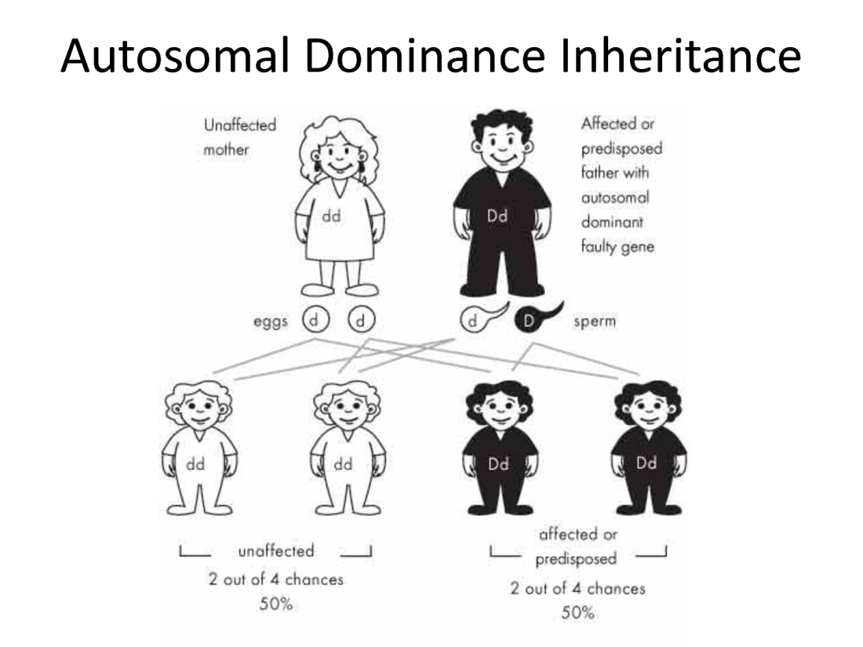
Lynch syndrome
Autosomal dominant
Inherit a germ line mutation in one of several DNA mismatch repair (MMR) genes.
Ahnen -2013

Slide 11
? Role of Mismatch repair (MMR) genes
Proofreads DNA for mismatches generated during DNA replication
MMR inactivation →
↑ mutation rate in dividing cells →
↑tumorigenesis

Slide 12
MMR Genes and MSI
Microsatellites
short repetitive DNA sequences
Defective MMR G→
abnormalities in the length of microsatellites = microsatellite instability (MSI)
Cancers > 40% microsatellite variations = high frequency MSI (MSI High)
MSI High molecular signature of Lynch-associated cancers

Slide 13
Lynch syndrome
Inherit one abnormal allele
MLH1
MSH2
MSH6
PMS2
70% MLH1 MSH2
EPCAM Epigenetic silencing of MSH2
Defective MMR
Inactivation of both alleles MMR gene
Second allele though
mutation,
loss of heterozygosity,
epigenetic silencing by promoter hypermethylation.

Slide 14
dMMR
Germ- line Vs Sporadic
7.2-15% Lynch syndrome
Reminder Sporadic
epigenetic silencing of the promoter region of MMR genes
predominantly MLH1

Slide 15
Testing for Lynch Syndrome
1)Test the tumour
Microsatellite instability or immunohistochemistry of MMR genes
IHC
Sensitivity 83%, Specificity 89%
MSI
Sensitivity 77-89%, Specificity 90%
2)? Sporadic
BRAF V600E mutation , Germline wildtype
3) Genetic Testing

Slide 16
Lynch Syndrome ? Who to screen

Slide 17
Who to test?
Up to 50% of patient with LS fail to meet the revised Bethesda(NCCN guidelines)

Slide 18
Who to test?
Revised Bethesda Criteria
CRC diagnosed in patients younger than 50 years of age
Presence of synchronous or metachronous colorectal or other LS related tumors regardless of age
CRC with histology diagnosed in a patient <60 years old
CRC in a patient with one or more first degree relatives with a less related cancer, with one of the cancers occurring under the age of 50
CRC diagnosed in a patient with two or more first or second degree relatives with LS related cancers regardless of age

Slide 19
Who to Test?
Endometrial ca

Slide 20
Implications for a diagnosis of Lynch Syndrome
Patient:
Cancer Risk
Prognosis
Adjuvant treatment
Risk to family members
Insurance

Slide 21
Cancer Risk in Lynch Syndrome

Slide 22
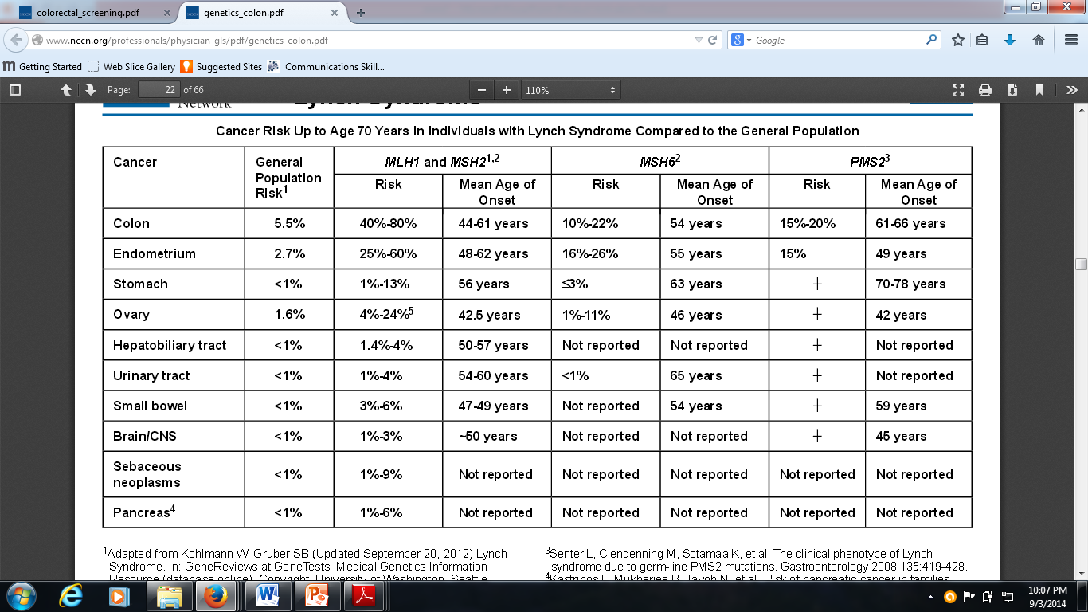
NCCN Guidelines Cancer risk up to 70

Slide 23
MMR defects and Adjuvant Chemotherapy

Slide 24
MMR defects and Adjuvant Chemotherapy CRC
Fluoropyrimidine-based adjuvant systemic therapy
Clearly shown to have benefit in patients with stage III CRC
Stage II colon cancer controversial
dMMR predictive lack of benefit to single agent fluoropyrimidine-based chemotherapy
? Difference dMMR germ-line mutations vs sporadic
.(Sinicrope FADNA mismatch repair status and colon cancer recurrence and survival in clinical trials of 5-fluorouracil-based adjuvant therapy.
J Natl Cancer Inst 2011 Jun 8;103(11):863-75. +

Slide 25
MMR defects and Adjuvant Chemotherapy Endometrial cancers
Rx similar

Slide 26
Surveillance for patients with Lynch Syndrome

Slide 27
Surveillance (NCCN)
CRC
Colonoscopy to begin 20-25y
or 2-5 years younger than the youngest family diagnosis
If MSH6 can start later 30y
Endometrial /Ovarian
Education to enhance recognition of relevant symptoms
No evidence for routine screening
Annual endometrial sampling is an option
TVU + Ca 125 not recommend, insensitive and not specific
Consider TAH/BSO
Urotherial CA in MLH1
Annual urinalysis from 25y
No clear endience for screening for gastric, duodenal small bowel

Slide 28
Prevention
CAPP2
861 with LS
600mg Aspirin vs placebo for up to 4 years
Median FU of >4 years
People taking Aspirin for >2 years 59% reduction in the incidence of CRC HR.49 95%CI .19- 1.86 p=.02
Problems with the study
More studies required
Aspirin however generally recommended

Slide 29
Hereditary Breast and Ovarian CA
Family history breast and/or ovarian cancer is common
BUT
<10 % breast cancers
< less than 15 % of ovarian cancers
associated with germline (inherited) genetic mutations

Slide 30
BRCA 1/2

Slide 31
Characteristics of BRCA 1/2

Slide 32
Characteristics of BRCA 1/2
Multiple cases w/i same family
Early age of onset
Bilateral breast CA
Synchronous cancers
Associated malignancies in patient/family members
Male Breast CA

Slide 33
Characteristics of BRCA 1/2 Classic Histological features
Breast CA
BRCA 1
Grade 3
Triple negative (80%)
Little DCIS, ↑incidence medullary cancer
BRCA 2 no defining histological features
Ovarian
Most serous papillary ovarian ca
85%
Vs in sporadic 40%

Slide 34
What are BRCA 1 and 2?
Tumor suppressor genes
Play a number of roles in the maintenance of genome integrity
DNA repair
Regulation of cell cycle check points
Homologous recombination
BRCA 1
located on chromosome 17q21.
BRCA2 gene
located on chromosome 13q

Slide 35
BRCA 1 and 2
Mutation inherited in Autosomal Dominant
Incomplete penetrance
>1000 different mutations reported
lead to a shortened abnormal protein when translated.
↑genomic instability and tumorigenesis
Prevalence
.25 % general population European ancestry
2.5 % Ashkenazi Jewish ancestry

Slide 36
Cancer Risk with BRCA 1/2

Slide 37
NCCN
Common CA:
Breast, ovarian, prostate ad pancreatic cancer
% Risk up to age 70 | BRCA 1 | BRCA 2
Breast | 60% | 55%
Ovarian | 59% | 16.5%
Contralateral Breast | 83% | 62%
Male Breast CA | Undefined | <10%
Prostate CA | Undefined | 5-7 x normal

Slide 38
Other CA
BRCA 1
cervix, uterus, fallopian tube, primary peritoneum, pancreas, esophageal, stomach, and prostate cancers
BRCA2
stomach, gallbladder, bile duct, esophagus, stomach, fallopian tube, primary peritoneum, and skin

Slide 39
BRCA 1 vs 2
Key differences Difference:
Male ca and pancreatic >BRCA 2
Ovarian < BRCA 2
NB
Changes in BRCA not seen in sporadic breast CA
Sporadic BRCA mutations seen in ovarian CA

Slide 40
Testing

Slide 41
Genetic testing Who to Test ? (EVIQ)
1)Computer scoring system >10%
BOADICEA ,BRCAPRO
Manchester score >16
2)Who are obligate carriers
3)Triple negative BC < age 40 yrs
4)Grade 2-3 invasive non-mucinous ovarian, fallopian tube or primary peritoneal cancer < age 70 yrs
5)Invasive non-mucinous ovarian, fallopian tube or primary peritoneal cancer at any age
a family history of breast or ovarian cancer
Or
a personal and/or family history* of breast and/or ovarian cancer, from a population where a common founder mutation exists
6)Where a known pathogenic mutation has been identified
(Predictive testing)

Slide 42
? When to refer to FCC for Screening
Dx Breast CA < 45y
Non-mucinous Ovarian, fallopian tube or primary peritoneal cancer Grade 2-3
2 Breast Primaries synchronous or asynchronous
1 dx < 50y
Breast CA< 50y with a relative with breast CA
Breast CA Dx at any age with a relative with Breast <50
Dx any age with 2 or > relatives with Breast CA or 1 with ovarian
Dx at any age with 2 more relatives wit pancreatic CA or prostate CA
Triple –ve Breast CA <60
Close male relative with Breast CA
If in doubt refer to a FCC

Slide 43
MX post Dx (NCCN)
Family Genetic counseling
Surveillance
Prevention
Risk Reduction surgery
Consider chemoprevention

Slide 44
Surveillance

Slide 45
Female Surveillance Guidelines
Breast Awareness stating at 18y
Clinical breast exam every 6-12/12 from 25y
Breast screening
Annual from 25y
Or individualized based on earliest age of onset
25-29y MRI or Mammogram (If MRI unavailable)
>30-75y Mammogram + MRI annual
>75y in individual basis
NCCN Guidelines Hereditary Breast/Ovarian CA 2014

Slide 46
Male Surveillance Guidelines
Breast self exam and education from 35y
Clinical breast exam every 6-12/12 from 35y
Baseline mammogram aged 40
+ annual mammogram of gyencomastia on baseline study
Prostate screening for BRCA2
Other CA Surveillance
Men and Woman:
Education regarding the signs and sx od CA associated with BRCA

Slide 47
Prevention Risk reduction surgery
Bilateral total mastectomy
↓ breast cancer by at least 90% BRCA mutations and high risk Breast CA
NCCN:
Consider Bilateral mastectomy

Slide 48
Prevention Risk Reduction Surgery
Reduction salpingo-oophorectomy (RRSO)
↓ risk of ovarian or fallopian cancer by 80%
1-4.3 residual risk of primary peritoneal carcinoma
↓ of breast cancer by approximately 50%
NCCN:
Recommend salpingo -oophorectomy b/w 35-40y
Transvaginal U/S + CA-125 not effective screening

Slide 49
Chemoprevention
SERM
OCP

Slide 50
BRCA 1 and Implications for treatment of Breast and Ovarian CA

Slide 51
Chemotherapy
Backbone for systemic therapy in triple-negative breast cancer.
Consider platinum
Impaired HR→ Impair the cells’ ability to repair DNA cross-links
Platinum's alter structure of DNA further by intrastrand adducts and interstrand crosslinks
Impede cell division
? Greater efficacy in BRAC mutation carriers

Slide 52
PARP inhibitor
PARP1 an important regulator of the DNA base-excision–repair pathway
BRCA 1/2 impaired Homologous recombination + PARP inhibitor= synthetic lethality

Slide 55
Case 1
Mx:
Further family hx:
Estranged from father
Thus unclear family hx
BRAF IHC
WT
Genetic counseling
Refused
? Adjuvant Chemo
controversial

Slide 56
Case 2
Initial Rx
Adjuvant chemo
Y
AC-T + platinum
FEC- D
? RXT
Yes
Hormone rx
No

Slide 57
Implication for BRCA 1
Consideration of bilateral mastectomy
Recommend salpingo -oophorectomy
Genetic counseling for family members
Role of PARP inhibitor ?

