Slide 1
Prostate cancer: To screen or not to screen –
To treat or not to treat
Dr Oliver Klein – Medical Oncologist

Slide 2
Prostate Cancer | Epidemiology- Australia
Most common cancers 2012
Cancer related deaths 2010
Australian Institute of Health and Welfare

Slide 3
Prostate Cancer | Key Facts
1/6 men diagnosed with prostate ca during their life time
Median age at diagnosis: 68 years
Median age of death from prostate ca: 81 years
90% of cancers detected by screening
Lifetime risk to receive diagnosis of prostate ca doubled since introduction of PSA screening

Slide 4
Prostate Cancer | Key Facts
Less than 5% of patients present with metastases at time of diagnosis
Risk Factors:
Age
Family history (first degree relatives)
Ethnicity
Sites of metastatic disease: Bone, liver, lung

Slide 5
Prostate Cancer | Key Facts
(Walsh PC et al., 2007)

Slide 6
Prostate Cancer | Incidence - Mortality
(Hoffman RM et al., 2011)

Slide 7
Prostate Cancer | Case Vignette
A 66 year old man, AH, visits you for his biannual Health check. One of his friends has recently been diagnosed with prostate cancer and requests for a PSA testing. He has no family history for prostate cancer and no lower urinary tract symptoms
To screen or not to screen?

Slide 8
Prostate Cancer | Screening
Early detection/treatment of asymptomatic cancers prolong survival
Accurate test
Effective treatment that provides better outcomes if administered early
2000 – 75% of men older than 50 years undergoing PSA testing

Slide 9
Prostate Cancer | Screening
(Hoffman RM et al., 2007)

Slide 10
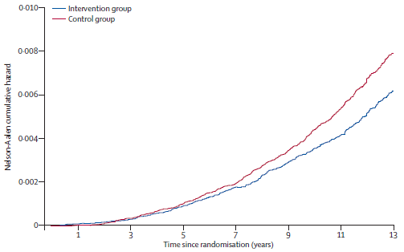
Prostate Cancer | Screening Trials - ERSPC
1 ½ more cancers in screening arm
But more than 50% Gleason6
21% reduction in prostate ca mortality
!781 to screen to avoid one death
?increasing benefit over time
Trial positive in Sweden/Netherlands bur not in Italy/Finnland
Positive in men 65-69 but not in 55-59 or 60-64
(Schroeder FH et al., 2014)

Slide 11
Prostate Cancer | Screening Trials - PLCO
Follow up to short
More than 50% of men in control group had screening performed
Only 40% underwent biopsy with abnormal initial PSA
(Andriole GL et al., 2009)

Slide 12
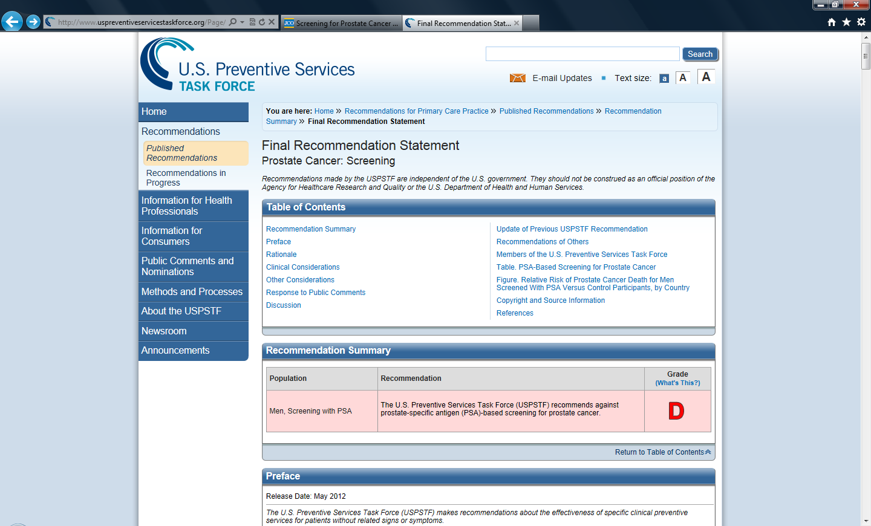
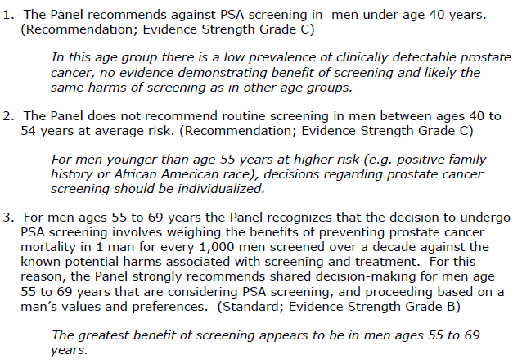
Prostate Cancer | Screening – What to do?

Slide 13
Prostate Cancer | Case Vignette
AH decides after informed discussion about the potential benefits and harms of PSA screening to pursue with testing
His serum PSA returns with 11.4 ng/ml
The clinical examination revealed a T2c tumour and a subsequent biopsy demonstrated adenocarcinoma, Gleason score 4+4 in 9/11 cores
A whole body bone scan and a CT scan of the abdomen/pelvis were unremarkable

Slide 14
Prostate Cancer | Treatments for localized prostate cancer
Radical prostatectomy +/- pelvic lymph node dissection
External beam radiotherapy
Expectant management/Active surveillance
(Androgen deprivation therapy)
Brachytherapy
(Kryotherapy)
(HIUF)

Slide 15
Prostate Cancer | Treatments for localized prostate cancer
Tumour related factors
Patient related factors
Clinical stage
PSA level
Gleason score
Number/percentage of cores involved
Life expectancy
Comorbidities
Preferences
cT2c
PSA 11.4 ng/ml
Gleason 4+4 in 10/11 cores
> 15 years
Arterial hypertension/Dyslipdemia
Nil preferences

Slide 16
Prostate Cancer | Case Vignette
AH decides to proceed with a radical prostatectomy with pelvic lymph node dissection
The histopathology demonstrates a pT3a, Gleason 4+4 adenocarcinoma with clear surgical margins. All lymph nodes are free of cancer
Recovery was unremarkable. Urinary continence was gained after a short period of time. He suffered moderate erectile dysfunction.
The serum PSA two months after the procedure is undetectable (<0.03 ng/ml)

Slide 17
Prostate Cancer | Case Vignette
AH has a regular three monthly follow up with his Urologist with his serum PSA being undetectable.
He returns as usual in his third year of follow up and his serum PSA has risen to 0.5ng/ml with a subsequent testing demonstrating a further rise to 0.8ng/ml. Pelvic imaging reveals no evidence for any local regional recurrence

Slide 18
Prostate Cancer | Case Vignette
AH has a regular three monthly follow up with his Urologist with his serum PSA being undetectable.
He returns as usual in his third year of follow up and his serum PSA has risen to 0.5ng/ml with a subsequent testing demonstrating a further rise to 0.8ng/ml. Pelvic imaging reveals no evidence for any local regional recurrence

Slide 19
20-50% of patients experience a biochemical relapse after RPT or definite RT
Prostate Cancer | Biochemical Relapse
Definition after RPT: PSA> 0.2 ng/ml
Definition after RPT: PSA> nadir+2ng/ml
Prognostic factors (Metastasis free survival/Overall survival)
PSA doubling time
Gleason score
Time to biochemical recurrence

Slide 20
Prostate Cancer | Biochemical Relapse - Treatment
Salvage Radiotherapy
PSADT
Time to biochemical recurrence
PSA level
Observation/Surveillance
Median time to metastasis for patients with PSADT<9months ~ 2 years but in patients with PSADT>15 months > 10 years
Median PSA at time of radiographic metastasis ~ 30ng/ml
ADT
Immediate vs deferred
Continuous or intermittent

Slide 21
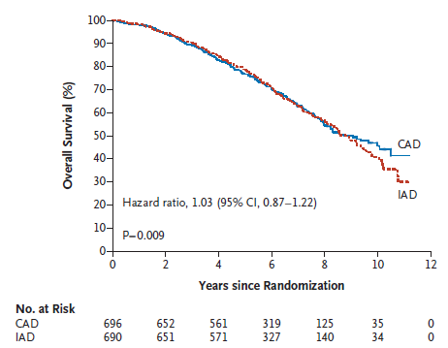
Prostate Cancer | Biochemical Relapse – Treatment/ADT
43.9 vs 15.4 months of ADT
Difference in hot flushes, libido, urinary symptoms
(Crook M et al, 2012)

Slide 22
Prostate Cancer | Biochemical Relapse – Treatment/ADT
(Gracia-Albinez X et al, 2014)

Slide 23
Prostate Cancer | Biochemical Relapse – Treatment/ADT
(Gracia-Albinez X et al, 2014)

Slide 24
Prostate Cancer | Case Vignette
AH undergoes the next two years three monthly PSA testing and the serum PSA has risen over last year significantly from 3.4 to 11.3 ng/ml. Imaging studies revealed no evidence for metastatic disease. He presents now for his three monthly follow up. His serum PSA has further risen to 21ng/ml and bone scan reveals evidence three bony metastases.

Slide 25
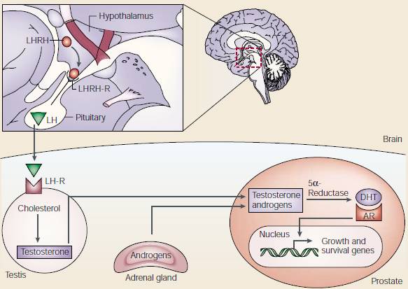
Prostate Cancer | Treatment-ADT
(Denmeade SR et al, 2002)

Slide 26
Prostate Cancer | Treatment - ADT
cholesterol
pregnenolone
17α-hydroxy-
pregnenolone
DHEA
androstenedione
Testosterone
DHT
(Harris et al, 2009)

Slide 27
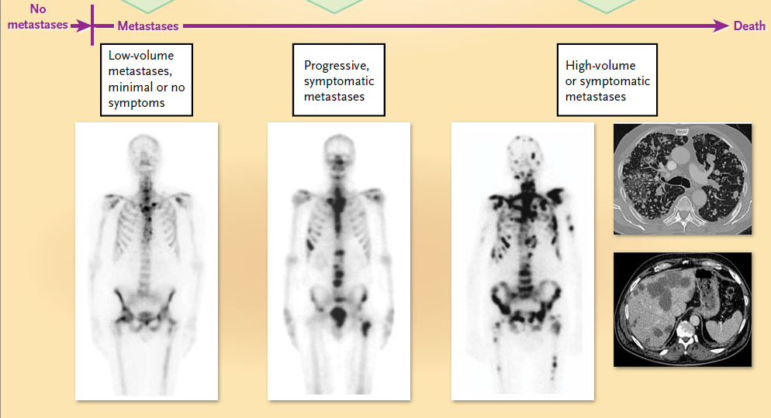
Prostate Cancer | Metastatic disease
(Antonarakis ES et al, 2011)

Slide 28
Prostate Cancer | Metastatic disease – Treatment
De novo metastatic disease( 5%) or developed from biochemical relapse
Castration sensitive
Castration resistent
1-3 years
~3 years
ADT +/- antiandrogens
Docetaxel
Abiraterone
Enzalutamide
Radium 223
Abiraterone
Enzalutamide
Cabazitaxel
Radium 223
Docetaxel
Zoledronic acid/ Denosumab

Slide 29
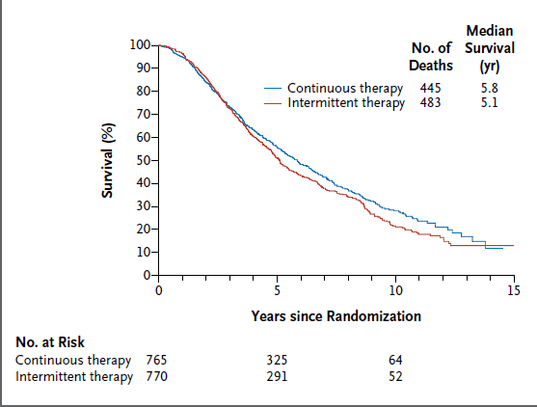
Prostate Cancer | Metastatic disease – Treatment/ADT
(Hussein M et al, 2013)

Slide 30
Prostate Cancer | Metastatic disease – Treatment/ADT
(Sweeney C et al, 2014)

Slide 31
Prostate Cancer | Metastatic disease – Treatment/ADT
(Sweeney C et al, 2014)

Slide 32
Prostate Cancer | Metastatic disease – Treatment/ADT
(Sweeney C et al, 2014)

Slide 33
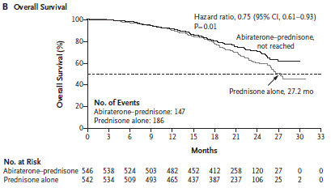
Prostate Cancer | Metastatic disease - Abiraterone
Pre-Docetaxel
Post-Docetaxel
(De Bono JS et al, 2011; Ryan CJ et al, 2013)

Slide 34
Prostate Cancer | Metastatic disease - Abiraterone
Pre-Docetaxel
Post-Docetaxel
(De Bono JS et al, 2011; Ryan CJ et al, 2013)

Slide 35
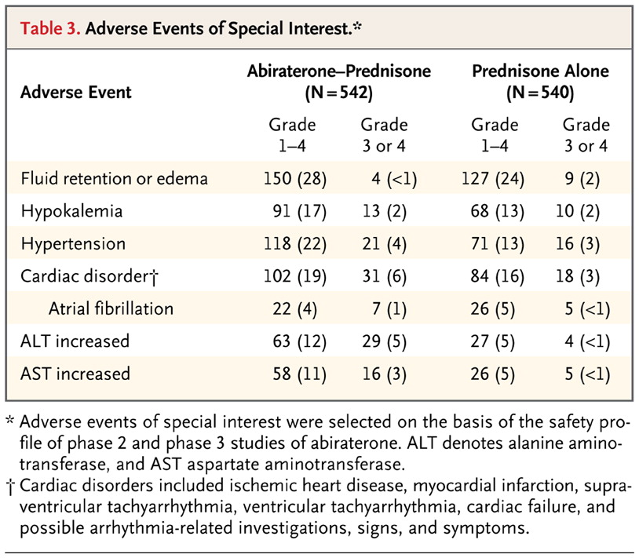
Prostate Cancer | Metastatic disease - Abiraterone
(Ryan CJ et al, 2013)

Slide 36
Prostate Cancer | Metastatic disease - Enzalutamide
Pre-Docetaxel
(Scher HI et al.,2012; Beer TM et al, 2014)

Slide 37
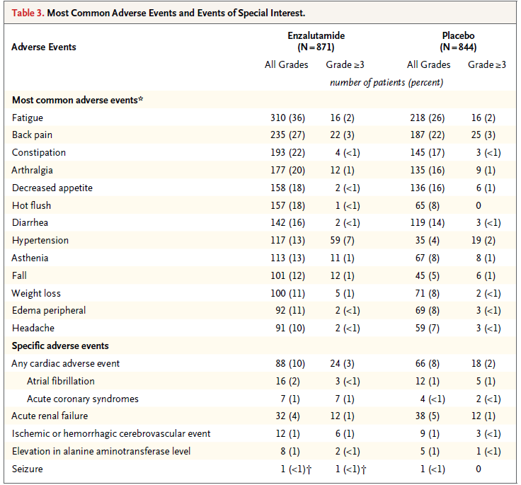
Prostate Cancer | Metastatic disease - Enzalutamide
(Beer TM et al, 2014)

Slide 38
Prostate Cancer | Metastatic disease – Treatment options
Agent | Increase in Median Survival | Relative reduction in risk of death
Abiraterone | 3.9 months | 35%
Enzalutamide | 4.8 months | 37%
Cabazitaxel | 2.8 months | 30%
Radium 223 | 2.8 months | 31%

Slide 39
Prostate Cancer | Metastatic disease – Conclusions
? Sequencing of new agents
preliminary evidence poor efficacy of Abiraterone after Enzalutamide and vice versa
?Cabazitaxel efficacy diminished after Abiraterone therapy
Combination therapies

